Slide 1
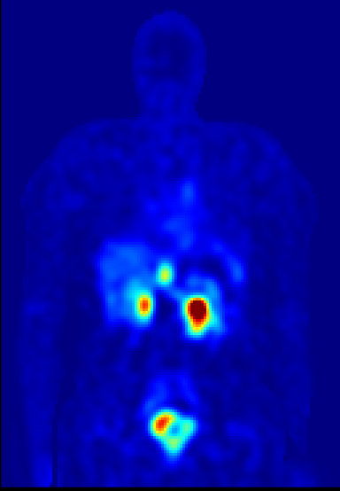
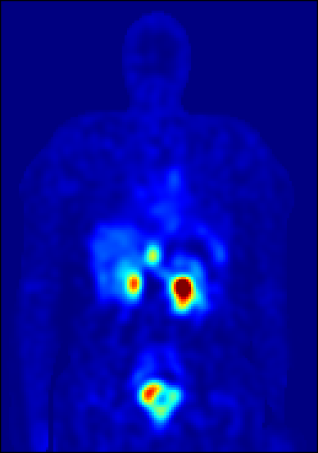
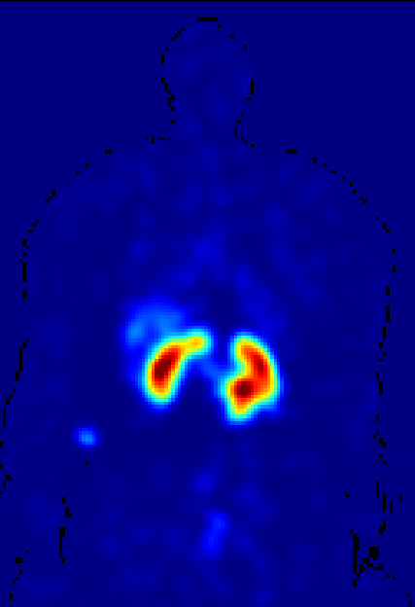
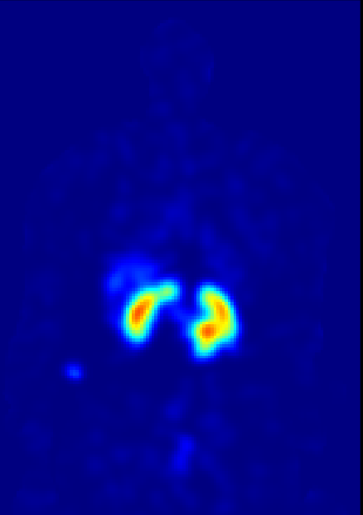
Dose conversion: VSV
Scan 1 SPECT
Scan 1 Dose rate map
Scan 4 SPECT
Scan 4 Dose rate map

Slide 2
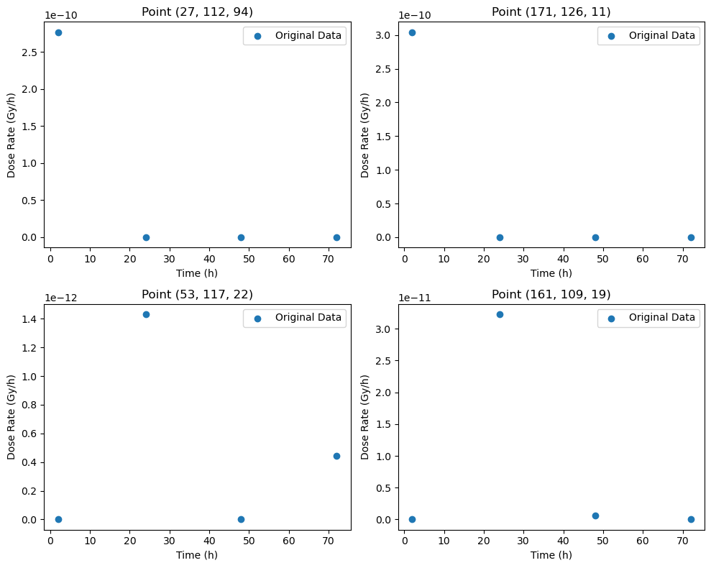
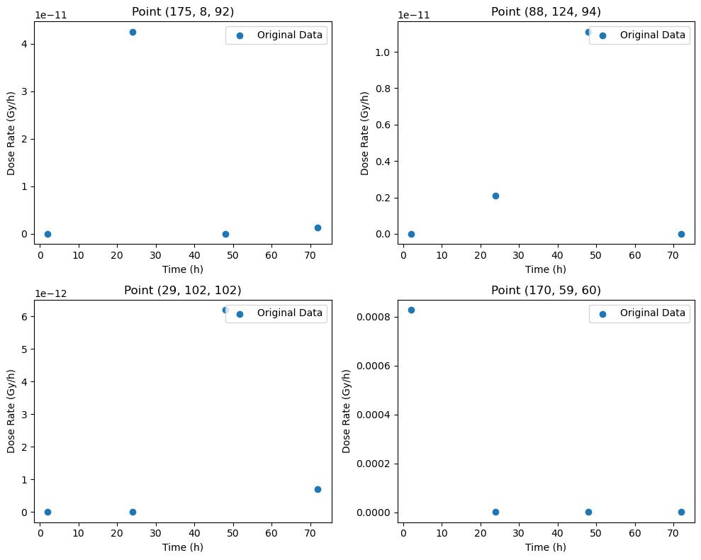
Curve fitting

Slide 3
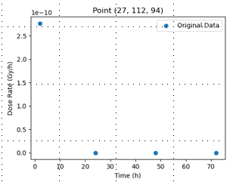
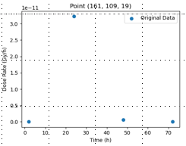
Case 1 & 2
Case1: time points 1 highest, then gradually decreased.
Case2: time points 2 highest, then gradually decreased.

Slide 4
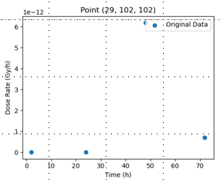
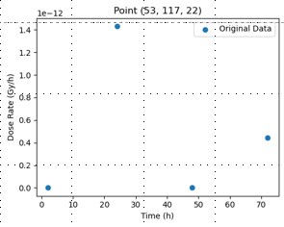
Special case

Slide 5
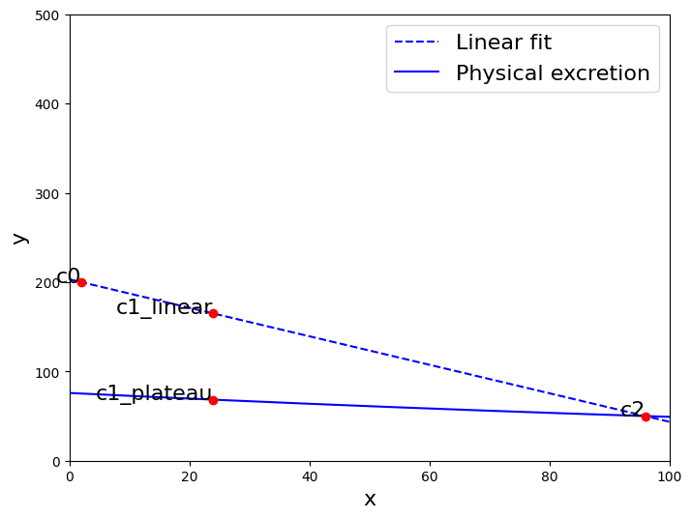
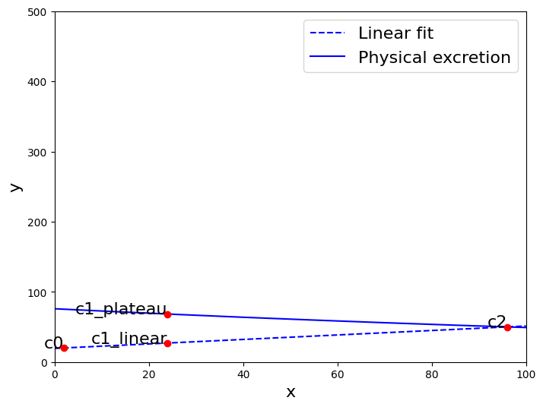
Methodology of triple exponential curve fitting
1. Input
[t0, t1, t2], [c0, c1, c2]
To avoid C0=C1, C0=C2, C1=C2 in computation, C0+0.0001, C1+0.0002, C2+0.0003
2. Two instances (c0<c2, or c0>c2)
Linear fit (t0, t2) and physical excretion (t2)
If c1<c1_plateau, c1_new= c1_plateau
If c1<c1_linear, c1_new= c1_linear

Slide 6
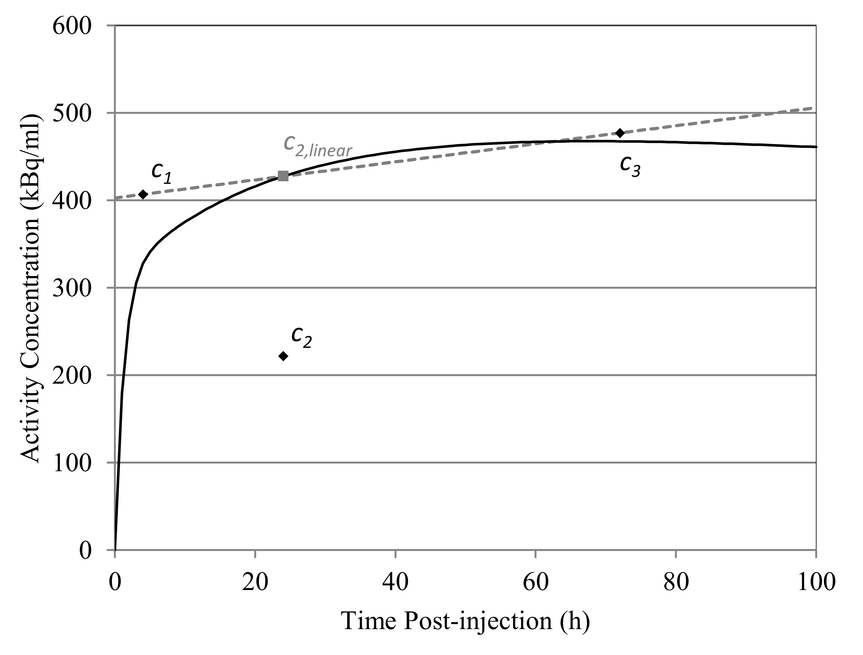
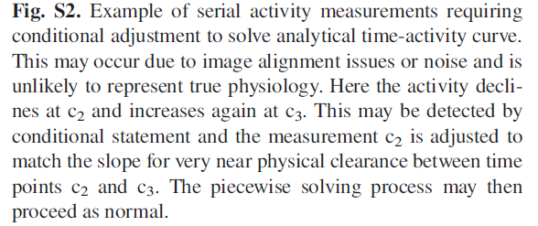
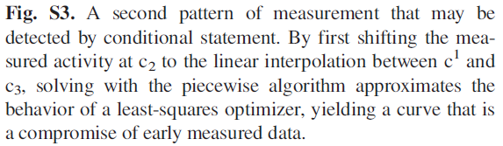

Slide 7
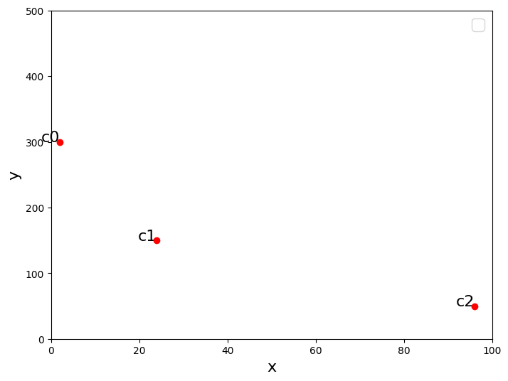
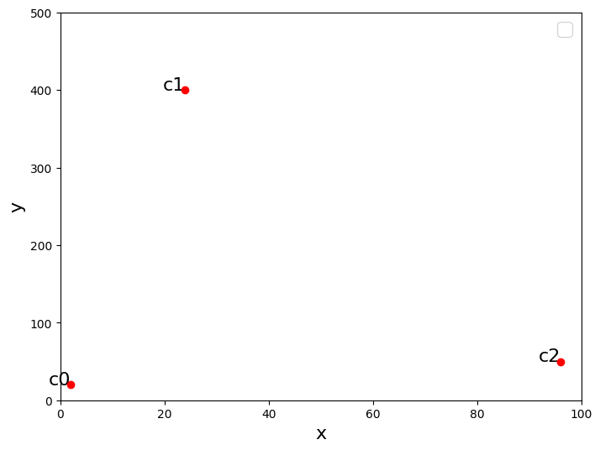
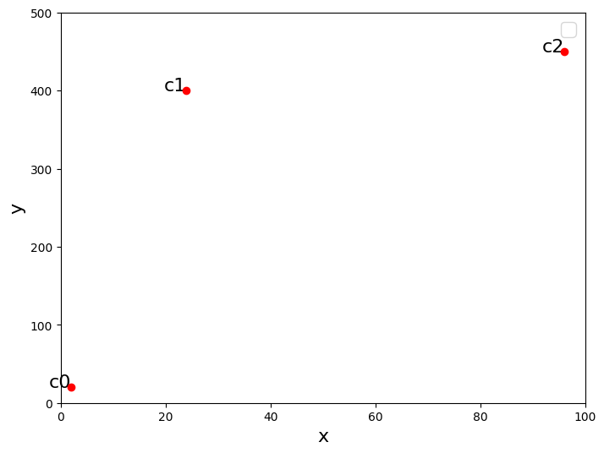
3 Instances

Slide 8
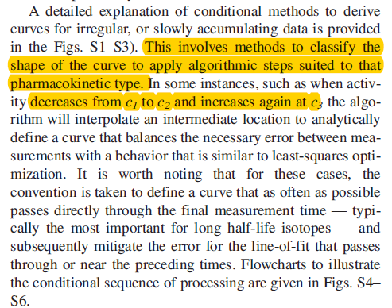
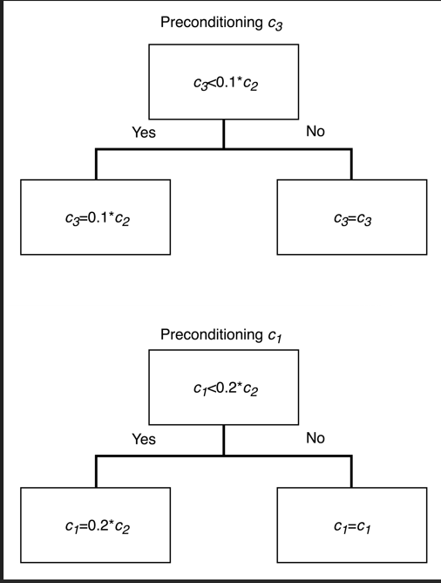
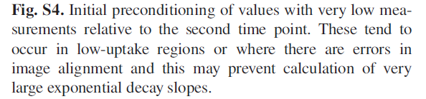
Classification of curve fitting instances

Slide 9
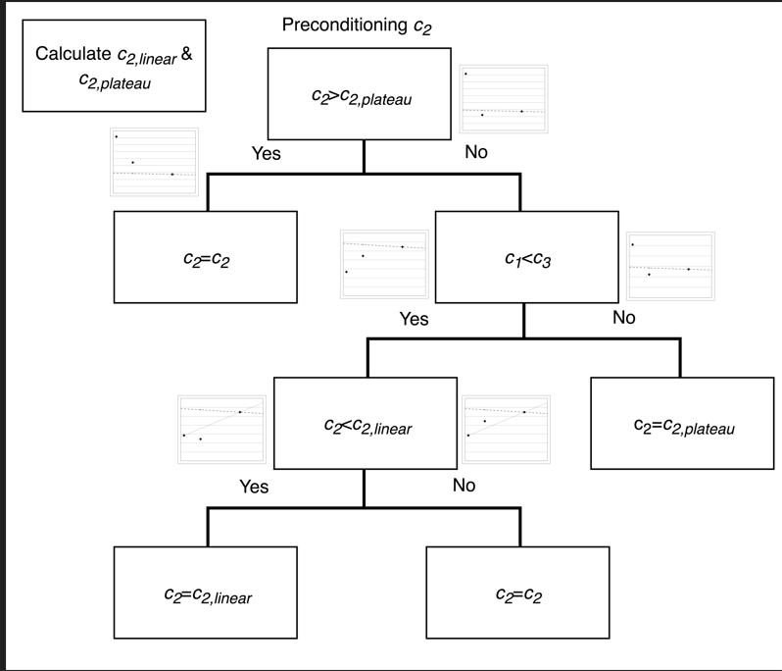

Slide 10
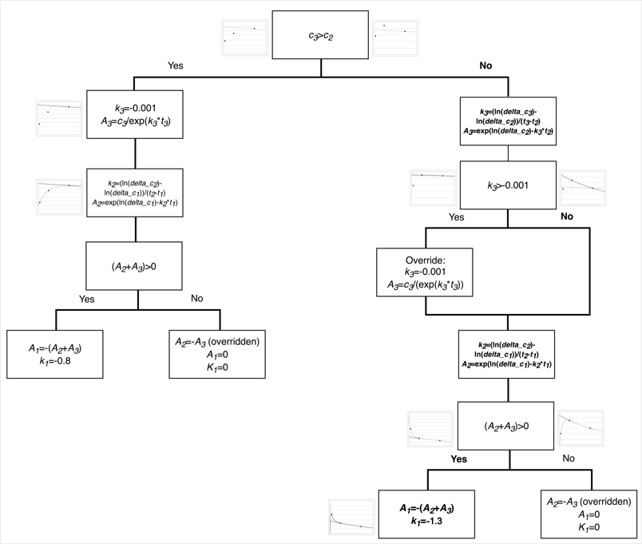
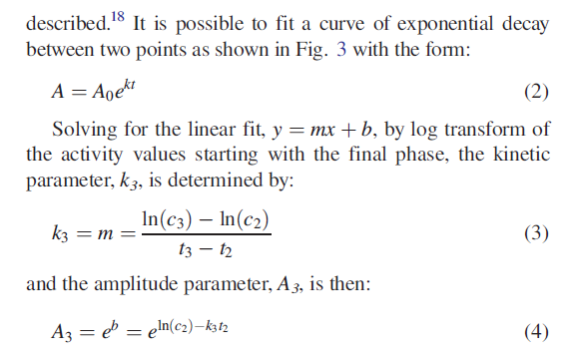
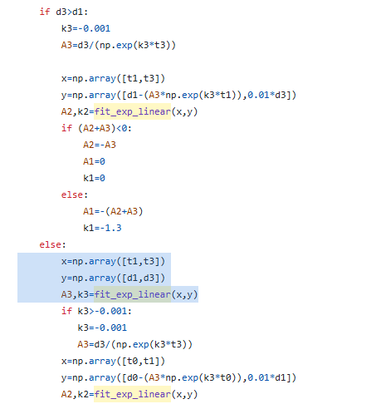

Slide 11
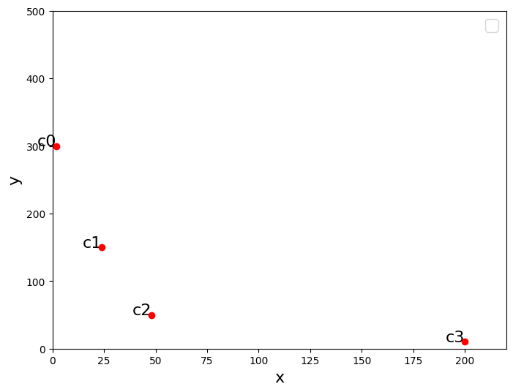
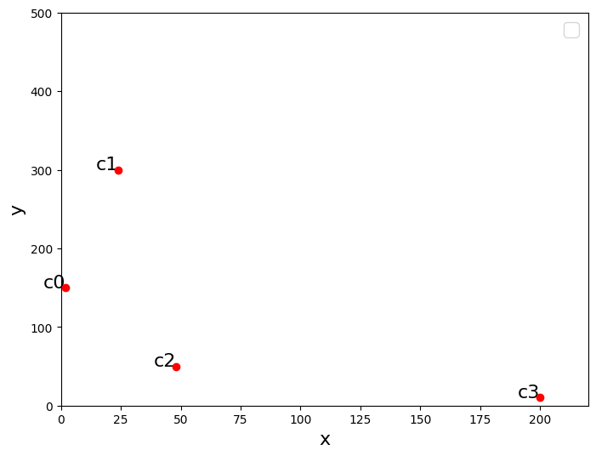
How to extend to 4 time points?
For 4 time points, based on the uptake up and down, total have 16 instances
1. When c0>c1>c2>c3, or c0<c1, c1>c2>c3 (common), c2 and c3 fit an exp curve, c0 and c1 fit an exp curve

Slide 12
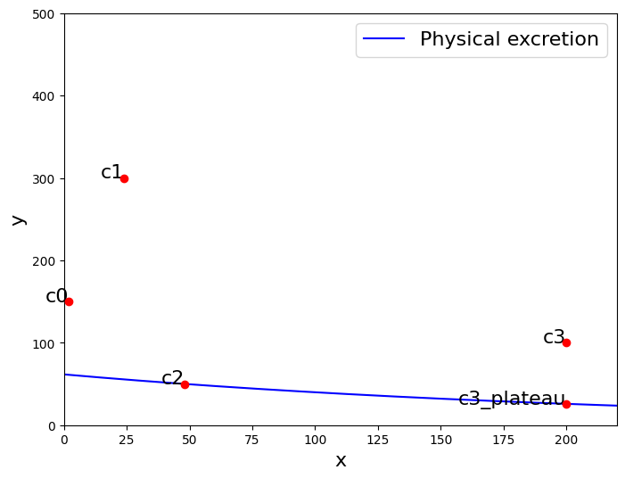
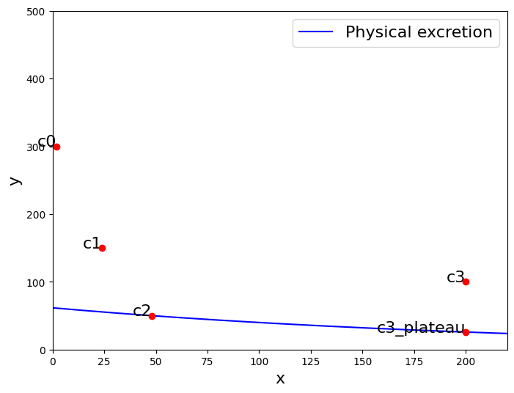
1-1, c0>c1>c2 or c0<c1, c1>c2; c3>c2

Slide 13
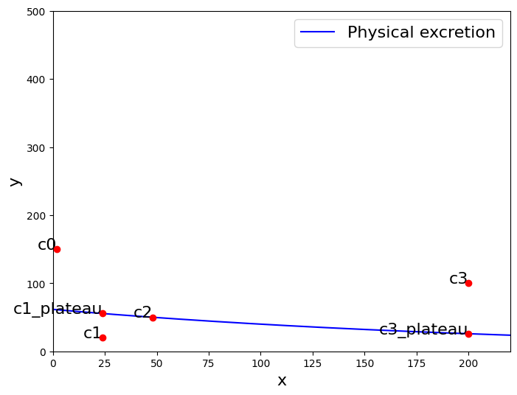
2. When c1<c0, and c1<c2 and c2<c0

Slide 14
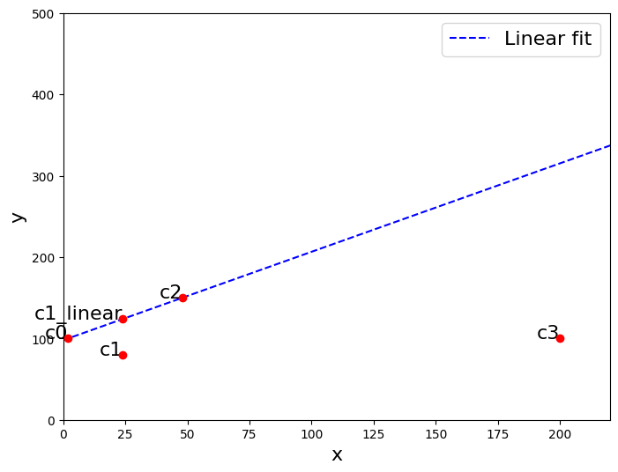
3. When c2>c0, if c1<c1_linear

Slide 15
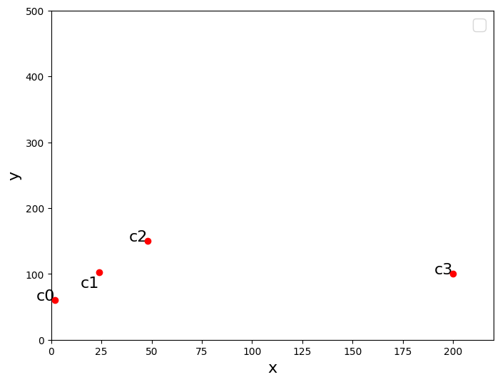
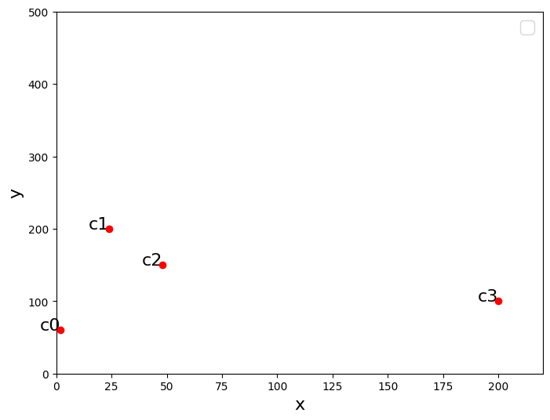
After pre-processing

Slide 16
Voxel based curve fitting
(128, 128, 183) matrix size using time: 20 min

